Slide 1
NoteShare System Architecture
Nathan Denklau
Nathan Fritze
Joe Trapani
Jonathan Hall
Satpreet Singh

Slide 2
Presentation Overview
Architectural Goals
High-Level Facebook Architecture
Architecture Overview
Mock-ups
Essential Use Case Example
Sequence Diagrams
Component Level View/Interfaces
ER Diagram

Slide 3
Architectural Goals
Facebook Interoperability and Usability
Common functionality should behave like a Facebook element
Integration with Facebook social network and features
Portability
Available on all platforms supported by Facebook

Slide 4
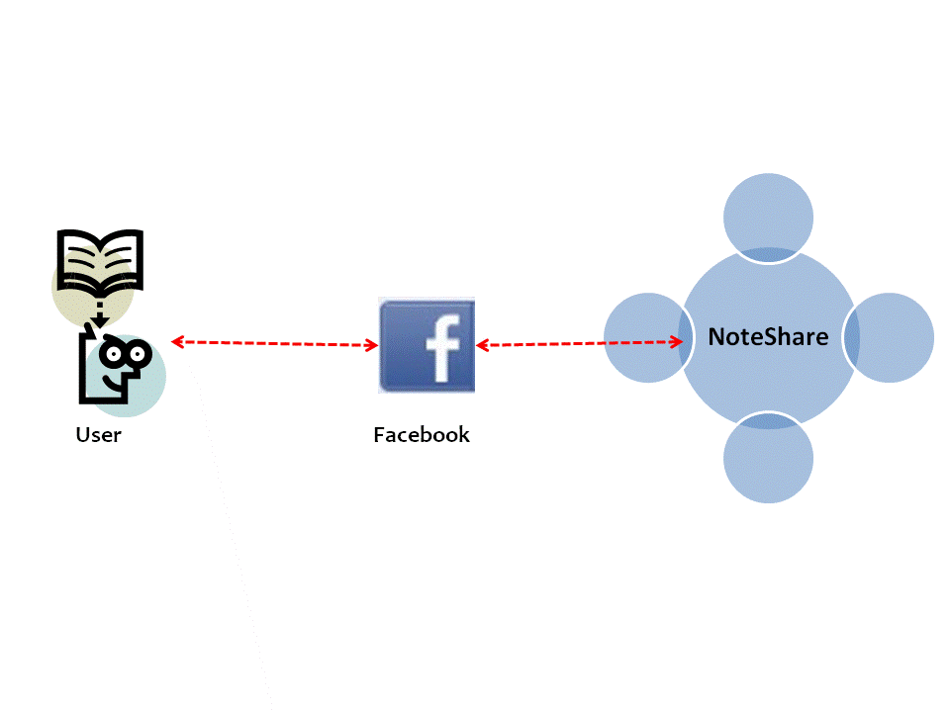
High-Level Facebook Interaction Architecture
Facebook provides two methods of integrating apps
FBML
iFrame
FBML apps provide a Facebook centric markup language (look and feel)
Facebook acts as an intermediary between User and NoteShare
Facebook FBML App

Slide 5
Architecture Overview
Model-View-Controller Web App
Model
Database Abstraction Layer, PHP script
MySQL server
FQL, Facebook server
View
Apache served PHP with FBML
Controller
PHP which handles Facebook user HTTP requests
Modifies the Model

Slide 6
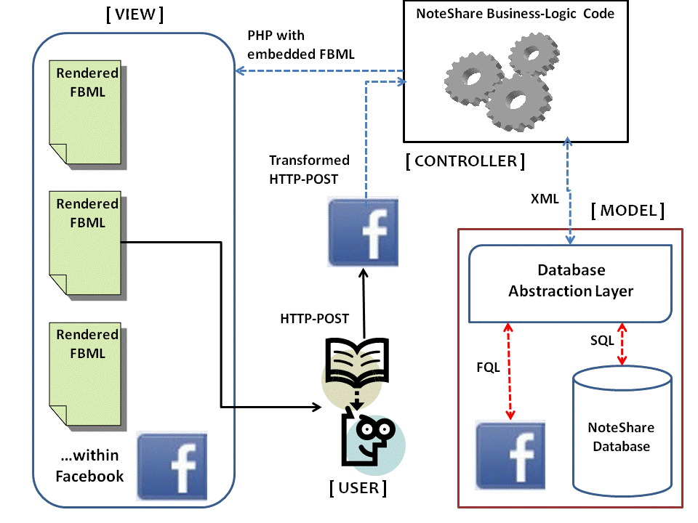
High-Level Component View

Slide 7
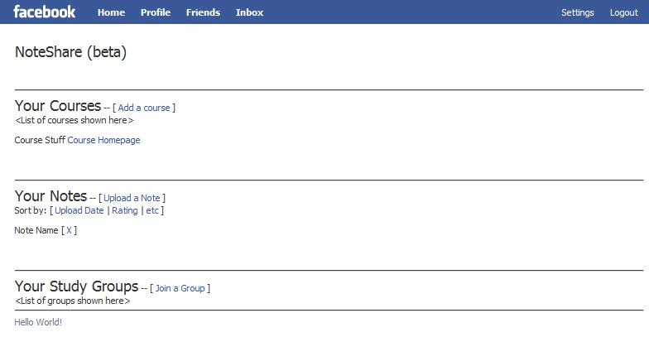
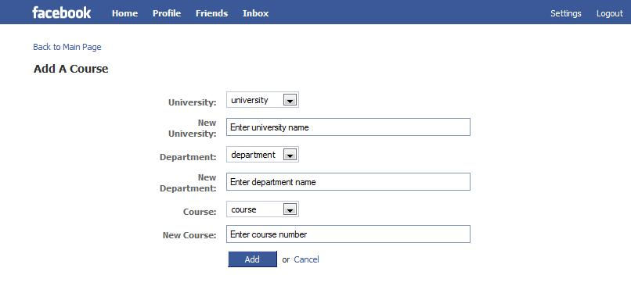
Mock-ups

Slide 8
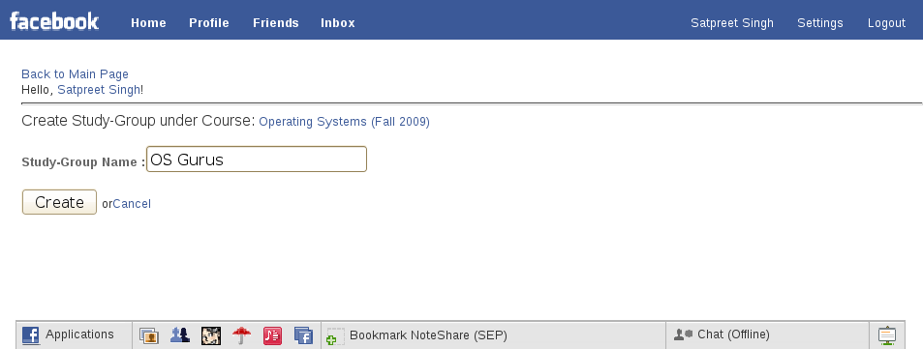
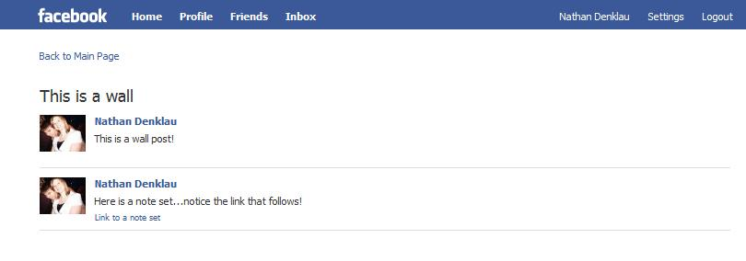
Mock-ups

Slide 9
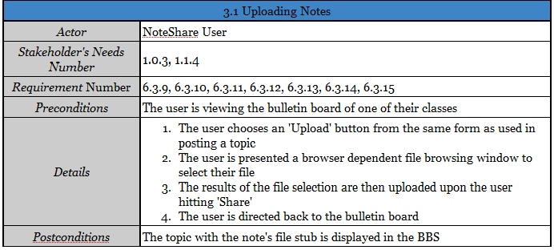
Essential Use Case Example

Slide 10
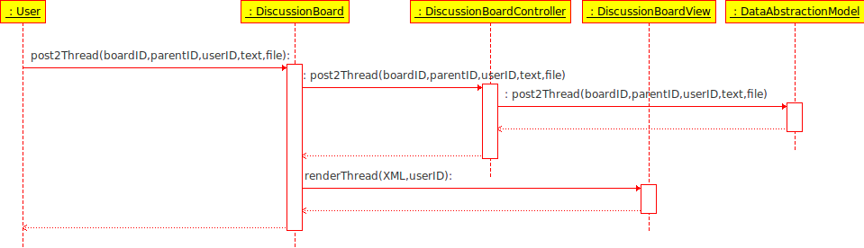
Sequence Diagram Post To Discussion Group

Slide 11
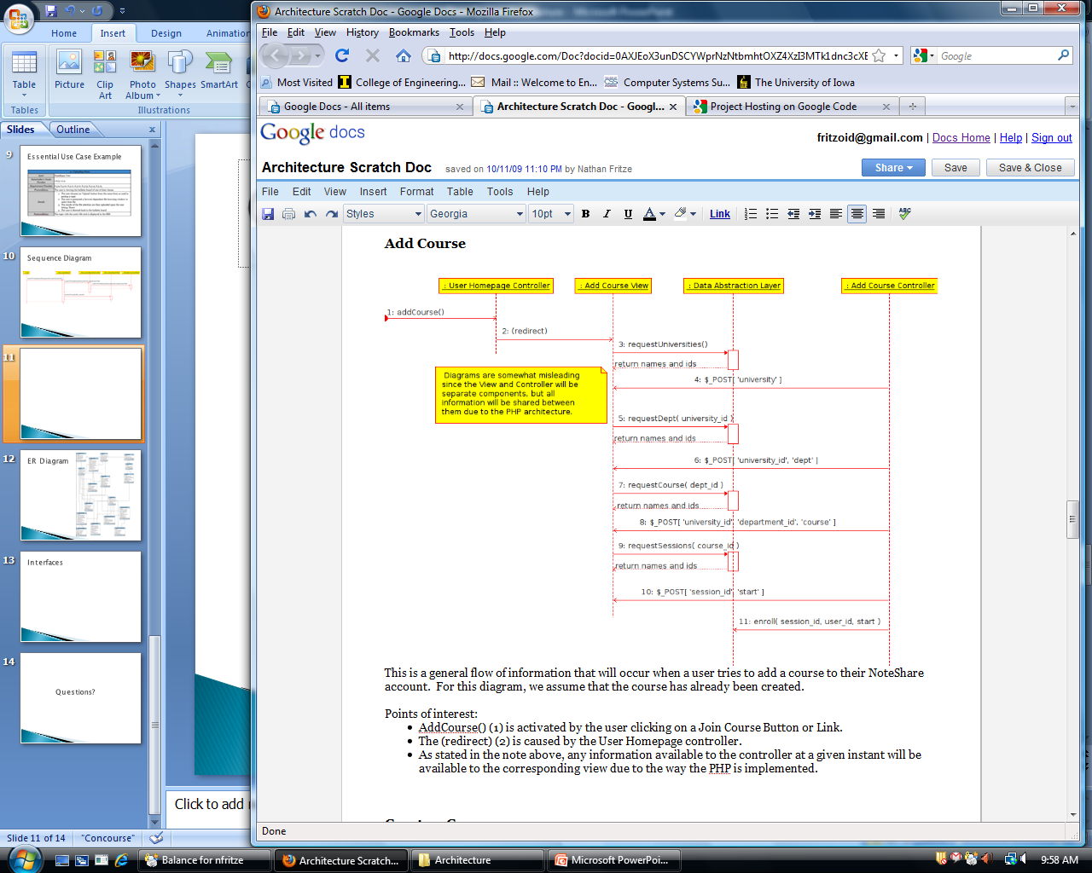
Sequence Diagram Add a Course

Slide 12
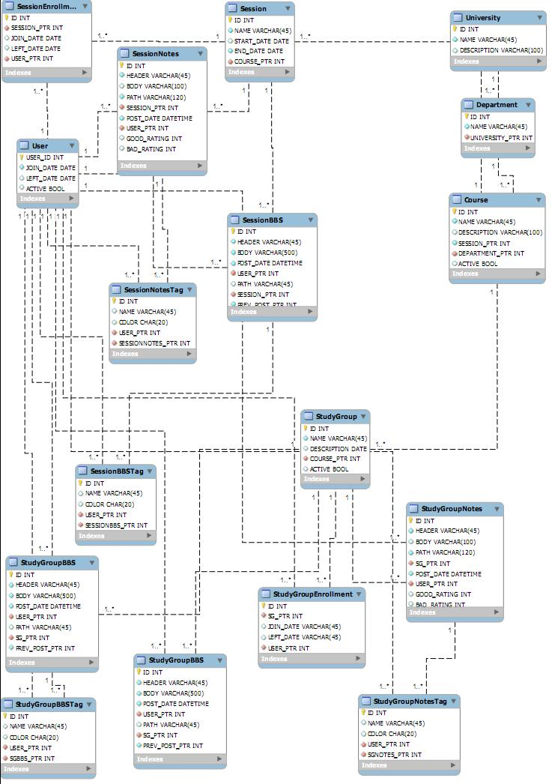
ER Diagram

Slide 13
Interfaces

Slide 14
Questions?

